Slide 1
Unphysical chaotic behavior due to round-off error

Slide 2
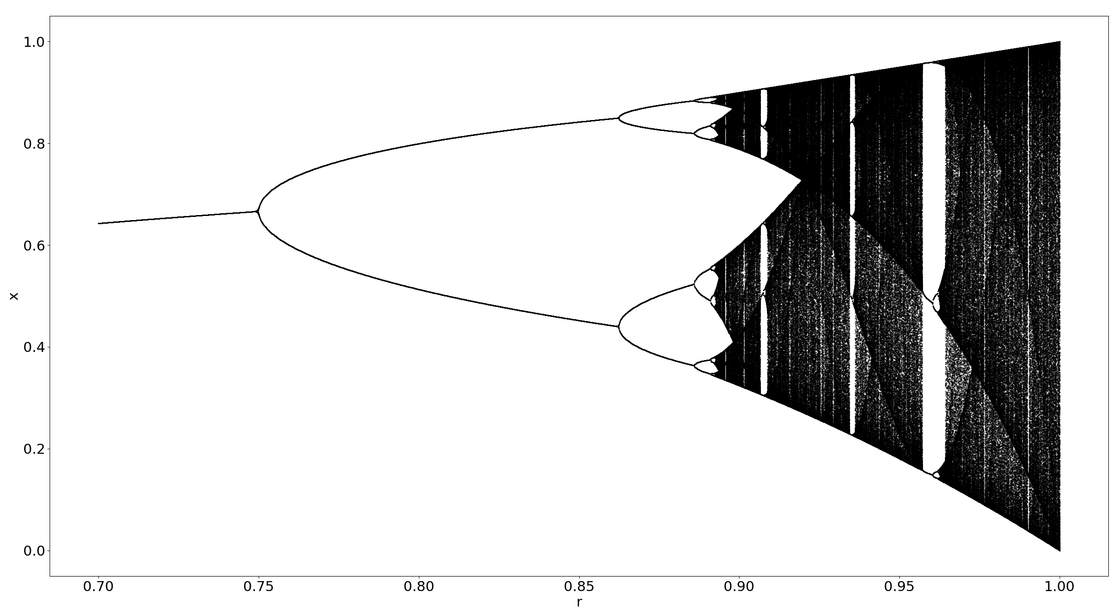
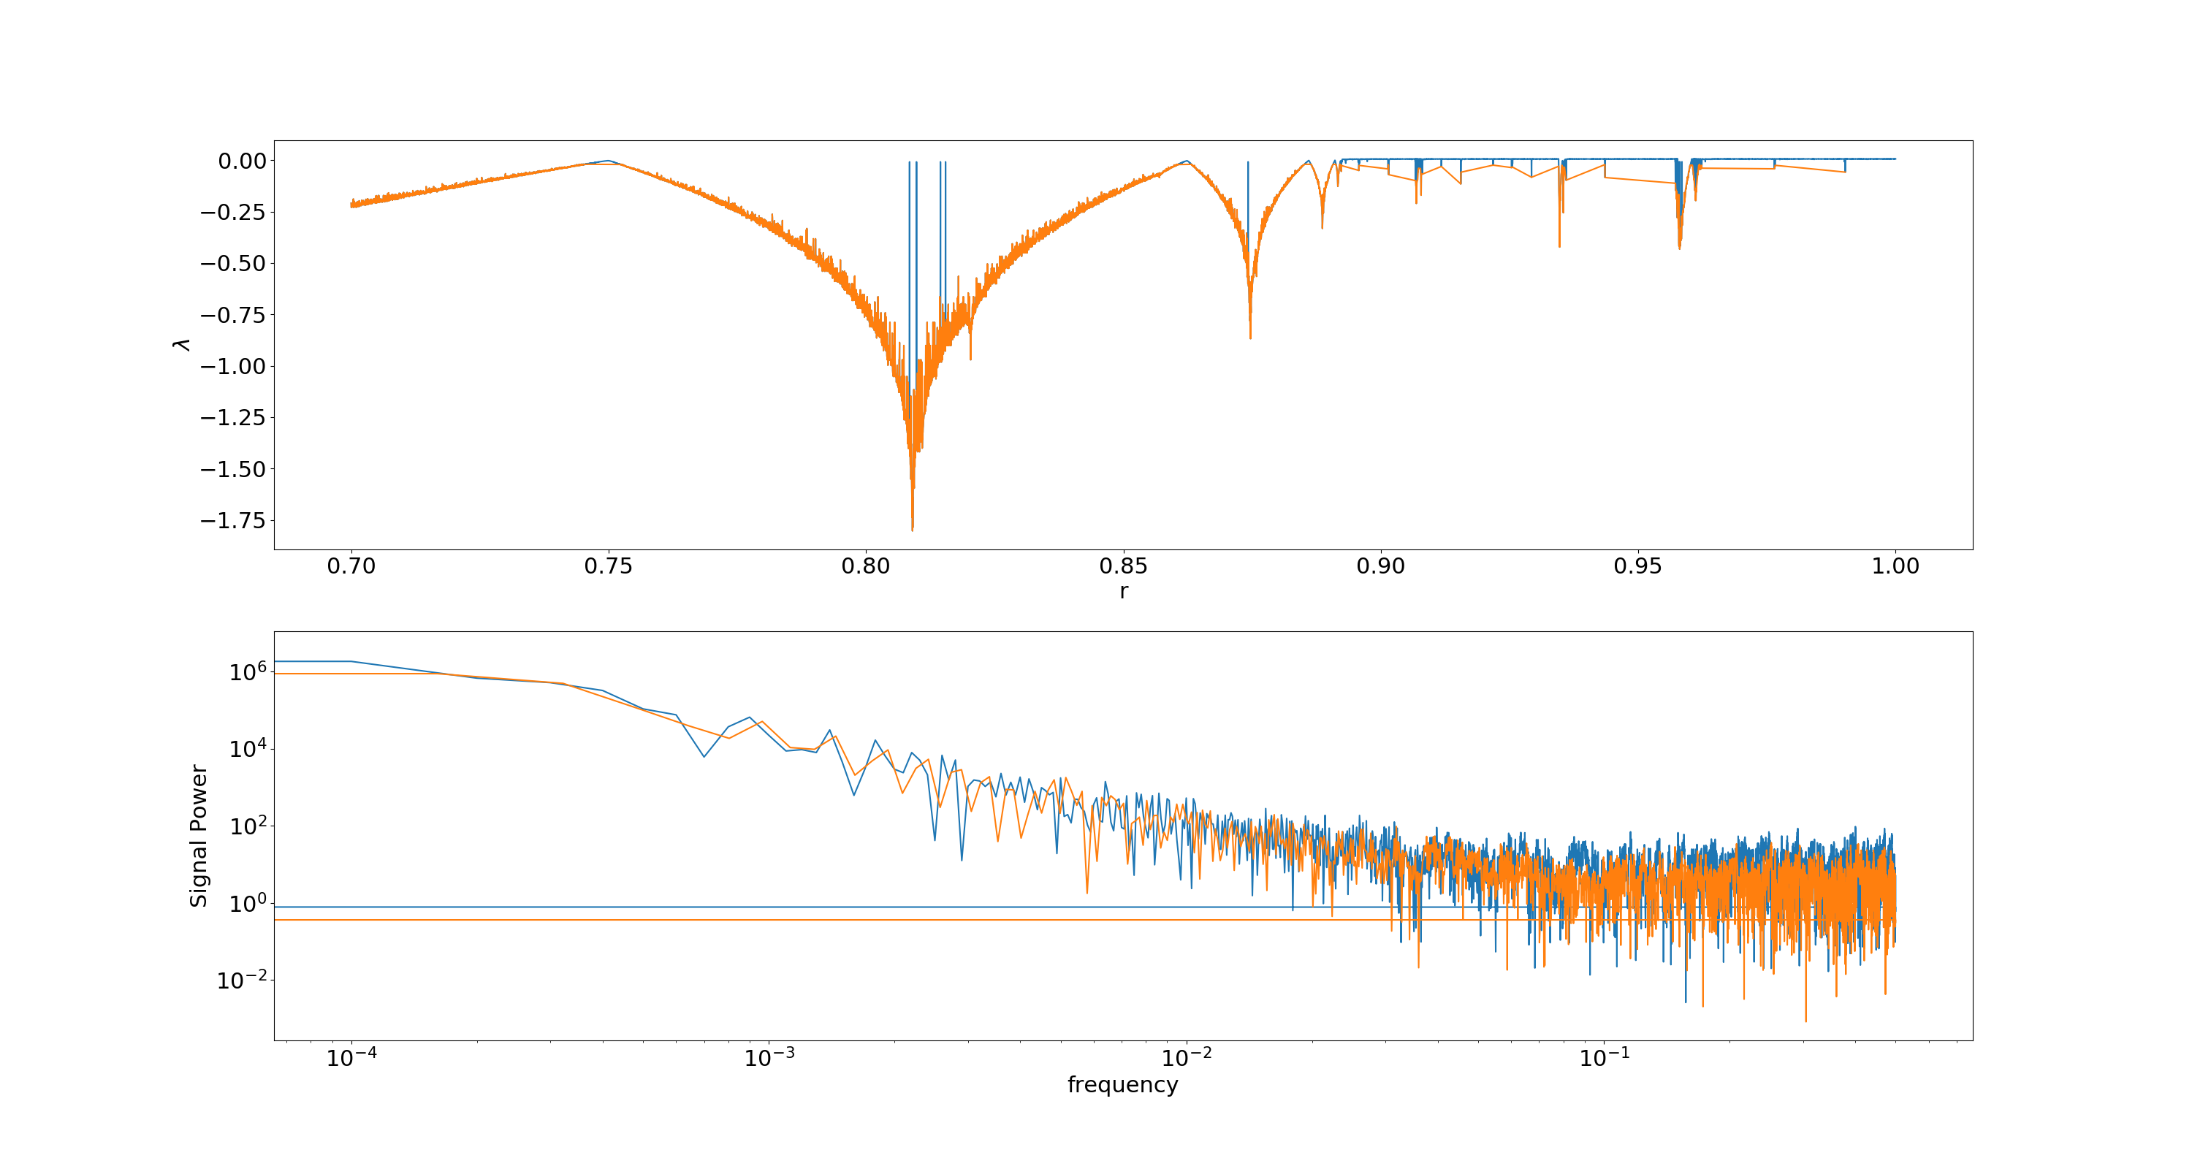
Abrupt chaotic behavior around the most stable regions?
Non-chaotic region
lambda< 0
Bifurcation points
lambda = 0
Chaotic region
lambda >0

Slide 3
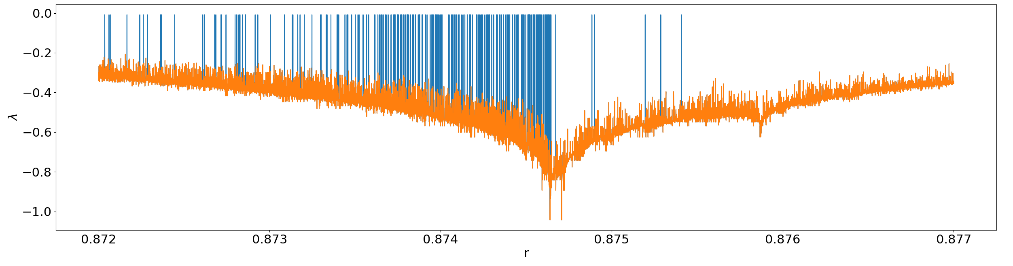
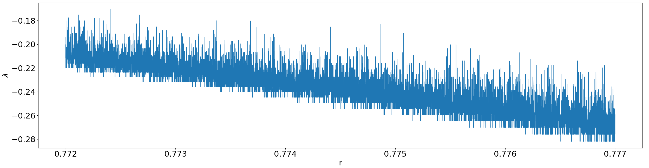
A bar code!
Scan it with my phone
Out appears the darkest secret of the universe

Slide 4
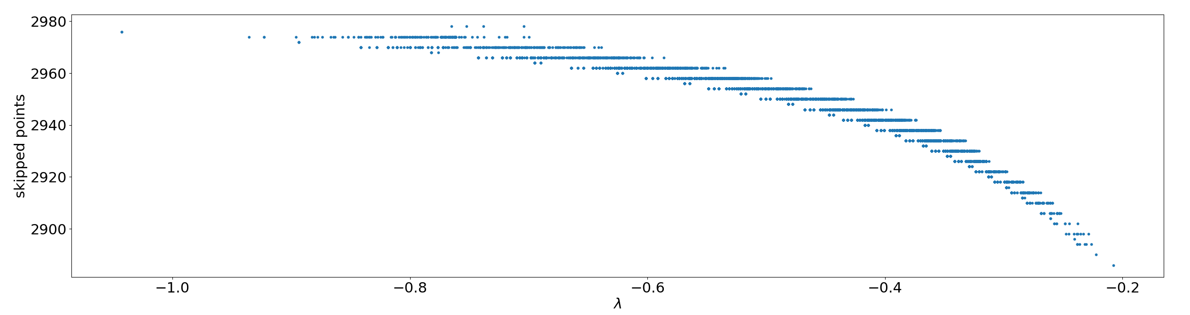
The Algorithm of suspicion
smaller difference
Division by zero
Invalid value encountered in log
Smaller difference
Division by zero
Exclude this from average

Slide 5
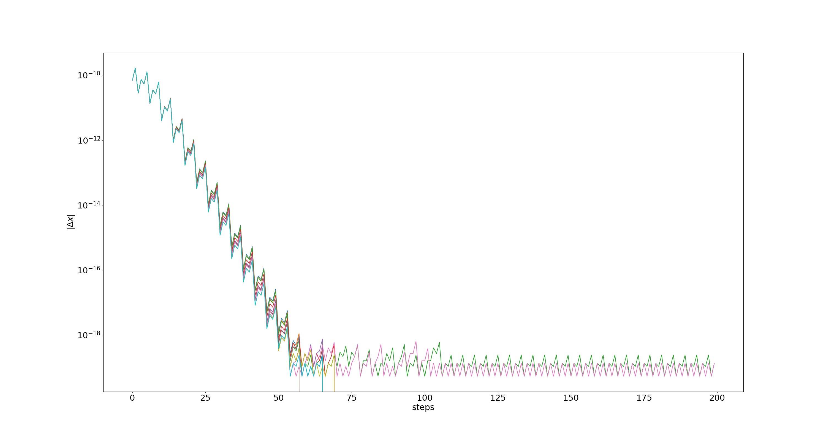
Abnormal points don’s skip, they oscillates!

Slide 6
More accurate calculation: absolutely normal

Slide 7
Lesson from this
Easy part: Getting the result
Difficult part: Testing and Proving it
Gather information against your results
The Truth is often simple and boring

